Slide 1
WHAT IS RAD
RAD model is Rapid Application Development model.
It is a based on prototyping and iterative development.
In RAD the Components are developed in parallel Manner.
It is a faster software development process.

Slide 2
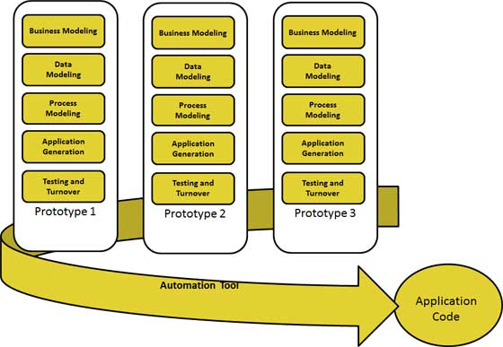
RAD MODEL

Slide 3
Business Modeling
The business model for the product under development is designed in terms of flow of information and the distribution of information between various business channels.
A complete business analysis is performed to find the vital information for business, how it can be obtained, how and when is the information processed and what are the factors driving successful flow of information.

Slide 4
Data Modeling
The information gathered in the Business Modeling phase is reviewed and analyzed to form sets of data objects vital for the business.
The attributes of all data sets is identified and defined.
The relation between these data objects are established and defined in detail in relevance to the business model.

Slide 5
Process Modeling
The data object sets defined in the Data Modeling phase are converted to establish the business information flow needed to achieve specific business objectives as per the business model.
The process model for any changes or enhancements to the data object sets is defined in this phase. Process descriptions for adding , deleting, retrieving or modifying a data object are given.

Slide 6
Application Generation
The actual system is built and coding is done by using automation tools to convert process and data models into actual prototypes.

Slide 7
Testing and Turnover
The overall testing time is reduced in RAD model as the prototypes are independently tested during every iteration. However the data flow and the interfaces between all the components need to be thoroughly tested with complete test coverage.
Since most of the programming components have already been tested, it reduces the risk of any major issues.

Slide 8
Applications of RAD
RAD should be used only when a system can be modularized to be delivered in incremental manner.
It should be used only if the budget permits use of automated code generating tools.
RAD SDLC model should be chosen only if domain experts are available with relevant business knowledge.
Should be used where the requirements change during the course of the project and working prototypes are to be presented to customer in small iterations of 2-3 months.

Slide 9
Pros
RAD model enables rapid delivery as it reduces the overall development time due to reusability of the components and parallel development.
RAD works well only if high skilled engineers are available and the customer is also committed to achieve the targeted prototype in the given time frame. If there is commitment lacking on either side the model may fail.
Changing requirements can be accommodated.
Iteration time can be short with use of powerful RAD tools.
Reduced development time.
Increases reusability of components
Quick initial reviews occur

Slide 10
Cons
Dependency on technically strong team members for identifying business requirements.
Only system that can be modularized can be built using RAD.
Requires highly skilled developers/designers.
Inapplicable to cheaper projects as cost of modeling and automated code generation is very high.
Suitable for systems that are component based and scalable.

Slide 11
V MODEL
The V-model is a type of SDLC model where process executes in a sequential manner in V-shape.
It is also known as Verification and Validation model. It is based on the association of a testing phase for each corresponding development stage.
Development of each step directly associated with the testing phase.
The next phase starts only after completion of the previous phase i.e. for each development activity, there is a testing activity corresponding to it.

Slide 12
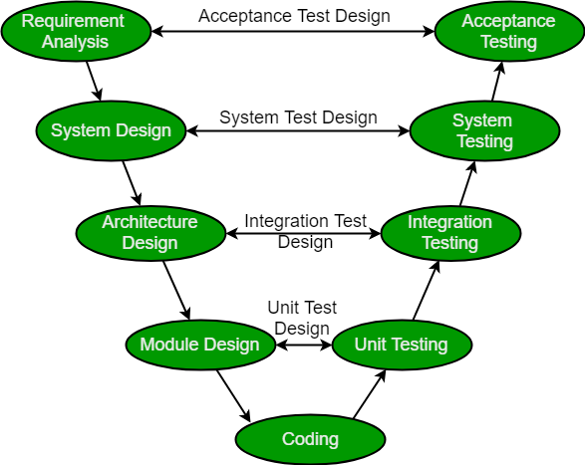
Diagram of V Model

Slide 13
Verification: It involves static analysis technique (review) done without executing code. It is the process of evaluation of the product development phase to find whether specified requirements meet.
Validation: It involves dynamic analysis technique (functional, non-functional), testing done by executing code. Validation is the process to evaluate the software after the completion of the development phase to determine whether software meets the customer expectations and requirements.
So V-Model contains Verification phases on one side of the Validation phases on the other side. Verification and Validation phases are joined by coding phase in V-shape. Thus it is called V-Model.

Slide 14
ADVANTAGES
Simple and easy to use.
Testing activities like planning, test designing happens well before coding. This saves a lot of time. Hence higher chance of success over the waterfall model.
Proactive defect tracking – that is defects are found at early stage.
Avoids the downward flow of the defects.
Works well for small projects where requirements are easily understood.

Slide 15
DISADVANTAGES
Requirements are well defined, clearly documented and fixed.
Product definition is stable.
Technology is not dynamic and is well understood by the project team.
There are no ambiguous or undefined requirements.
The project is short.

Slide 16
When to use the V-Shaped Model
All requirements are known up-front
Solution and technology are known
Project is short.
High confidence of customer is required for choosing the V-shaped model approach. Since, no prototypes are produced, there is very high risk involved in meeting customer expectations.

Slide 17
Questions asked in different Software Companies
What is the limitation of RAD Model?[TCS & Infosys]
What are the merits of the incremental model?[HCL]
What is the disadvantage of the spiral model? [TCS & Infosys]
Name the Evolutionary process Models.[Wipro]

